Slide 1


DIGITAL ELECTRONICS
For
B.Tech II year II Semester(Computer Science and Engineering-AI/ML)
By
Manish Kumar (Asst Prof , ECE)

Slide 2
DIGITAL ELECTRONICS
Syllabus for B. Tech II year II Semester,(Computer Science and Engineering-AI/ML)
Code: 8CC55
COURSE OBJECTIVES:
To learn the concepts of various number systems, design of Combinational and Sequential Circuits using Logic gates and PLDs.
COURSE OUTCOMES:
After completing this course, the students
Demonstrate an ability to understand number systems and apply the rules of Boolean algebra
to simplify Boolean expressions.
Demonstrate an ability to simplify of Boolean expressions using K-map.
Demonstrate an ability to design MSI combinational circuits such as full adders, multiplexers, decoders, encoders. Code converters.
Demonstrate an ability to design basic memory units (latches and flip-flops) and sequential
circuits such as counters and registers
Demonstrate an ability to design digital design using PLD’s such as ROM’s, PLA’s, PAL s.
Demonstrate an ability to design digital controllers using Algorithmic State Machine Charts .
1-Dec-23
Manish kumar Dept of ECE , SNIST

Slide 3
UNIT – I: Fundamentals of Digital Systems and logic families Digital signals, digital circuits, AND, OR, NOT, NAND, NOR and Exclusive-OR operations, signed binary, octal, hexadecimal number, number conversion. Characteristics of digital lCs, Error detecting and correcting codes.
UNIT – II: Boolean algebra Boolean algebra, Postulates and theorems, Standard representation for logic functions, K-map representation, simplification of logic functions using K-map, Boolean function minimization using Quine -Mclusky method.
UNIT – III Design of combinational circuits Design of Multiplexer, De-Multiplexer/Decoders, Adders, Subtractors, BCD arithmetic, digital comparator, parity checker /generator, code converters, ALU Design.
UNIT – IV Sequential circuits-I A 1-bit memory, the circuit properties of Bi-stable latch, the clocked SR flip flop, J- K, T and D-types flip flops, triggering mechanism of flip-flops, flip-flop conversion.
UNIT - V Sequential circuits-II Applications of flip-flops: Ripple (Asynchronous) counters, synchronous counters, counters design using flip flops, asynchronous sequential counters, shift registers, applications of shift registers, serial to parallel converter, parallel to serial converter, ring counter.
UNIT – VI Semiconductor memories and Programmable logic devices Memory organization and operation, expanding memory size, classification and characteristics of memories, sequential memory, read only memory (ROM), read and write memory(RAM), Programmable logic devices: PROM, PLD and PAL.
1-Dec-23
Manish kumar Dept of ECE , SNIST

Slide 4
Text Books
Morris Mano-,Digital design –PHI, 2nd Edition
.
Zvi Kohavi and Niraj K Jha -Switching & Finit e Automata theory – Cambridge, 3rd Edition.
Switching theory and logic design by Anand ku mar
Subrata Ghoshal, Digital Electronics,2012, Cen gage Learning
1-Dec-23
Manish kumar Dept of ECE , SNIST

Slide 5
Reference Books
Fletcher -An Engineering Approach to Digital Design – PHI.
Fundamentals of Logic Design, Roth, Kenny, Seventh Edition, Cengage Learning
R.P.Jain-Switching Theory and Logic Design- TMH Edition,2003.
John M. Yarbrough -Digital Logic Application s and Design – Thomson Publications, 2006
CVS Rao -Switching Theory and Logic Design –Pearson Education, 2005
1-Dec-23
Manish kumar Dept of ECE , SNIST

Slide 6
COURSE OUTCOMES
After completion of the course, the students u nderstand the following:
Number systems and apply rules of boolean a lgebra to simplify boolean expressions.
Simplify of boolean expressions using K-map
Design MSI combinational circuits such as fu ll adders, multiplexers, de-multiplexers, deco ders, encoders and code converters.
1-Dec-23
Manish kumar Dept of ECE , SNIST

Slide 7
Design of basic memory units(latche s and flip-flops) and sequential circui ts such as counters and registers
Design of ROM’s ,PLA’s and PAL’s using PLD’s
Design of digital controllers using al gorithmic state machines
1-Dec-23
Manish kumar Dept of ECE , SNIST

Slide 8
HISTORY
Till 1600 : Abacus
1600: Slide Rule by John Napier
1642: Adding Machine by Blaise Pascal
1820: Mechanical Computer by Charles Babbage
1930: Calculator using relays by Howard Aiken (H arvard) & George Slibitz (Bell labs)
1-Dec-23
Manish kumar Dept of ECE , SNIST

Slide 9
1947: Discovery of transistor by John Bardeeen, Walter H. Brittain and William Shockley
1950 : ENIAC (Vacuum Tube Computer) by Joh n Mauchly & Presper Eckert Jr. (Univ. of Pennsy lvania)
Stored Program Concept by John Von Neumann
Magnetic Core Memory by J. W. Forrester of MI T
late 1940s – late 1970s: Four generations of com puters
1-Dec-23
Manish kumar Dept of ECE , SNIST

Slide 10

UNIT-I
1-Dec-23
Manish kumar Dept of ECE , SNIST

Slide 11
Which logic components to choose?
There are many implementation technologies Ex: Programmable Logic devices, Transist ors on a chip etc.
The design may need to be optimized and/or t ransformed to meet design constraints
1-Dec-23
Manish kumar Dept of ECE , SNIST

Slide 12
Digital Systems
Digital vs. Analog Waveforms
+5
+5
1
0
1
V
V
Time
Time
–5
–5
Digital:
only assumes discrete values
Analog:
values vary over a broad range
continuously
1-Dec-23
Manish kumar Dept of ECE , SNIST

Slide 13
Advantages of Digital System over Analog System
Reproducibility of the results and accuracy
Flexibility and Functionality
Speed: Digital logic Element can produce an output in less than 10 nano seconds
Economy: Due to integration of millions of dig ital logic elements on a single miniature chip forming low cost integrated circuit
Less memory storage requirement
Easy to process the digital signals
1-Dec-23
Manish kumar Dept of ECE , SNIST

Slide 14
Applications of Digital Systems
Cellular and Mobile Communications
Business Transactions
Traffic Control
Space Guidance
Medical Treatment
Weather Monitoring
Internet of Things
Digital Television
Digital Cameras
1-D•ec-23Digital ComputMeanrishskumar Dept of ECE , SNIST
16

Slide 15
Digital circuit
An electronic circuit that accepts and processes binary data (on/off) according to the rules of Boolean logic (AND, OR, NOT, NAND, NOR and Exclusive-OR operations,EX-NOR).
1-Dec-23
Manish kumar Dept of ECE , SNIST
17

Slide 16
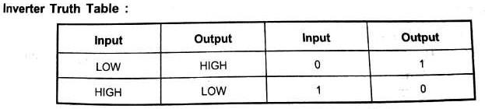
Inverter or The NOT Gate
12/1/2023
Manish Kumar(Asst prof,ECE)

Slide 17
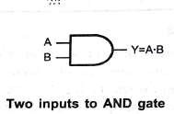
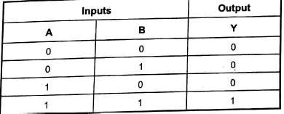
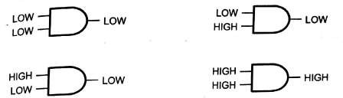
The AND Gate
12/1/2023
Manish Kumar(Asst prof,ECE)

Slide 18

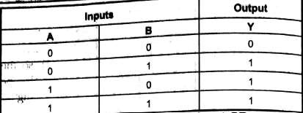
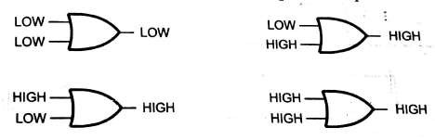
The OR Gate
12/1/2023
Manish Kumar(Asst prof,ECE)

Slide 19

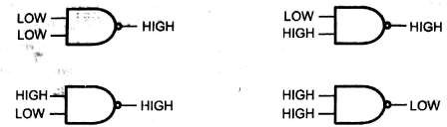
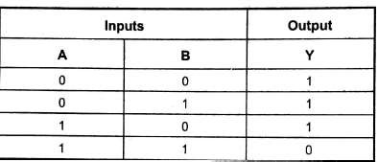
The NAND gate
12/1/2023
Manish Kumar(Asst prof,ECE)

Slide 20

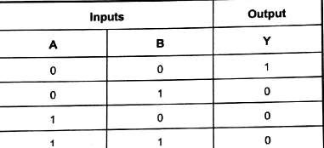
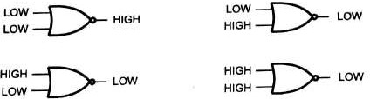
The NOR Gate
12/1/2023
Manish Kumar(Asst prof,ECE)

Slide 21

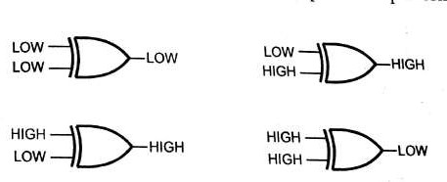
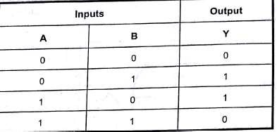
The Exclusive OR Gate(Ex-OR)
12/1/2023
Manish Kumar(Asst prof,ECE)

Slide 22

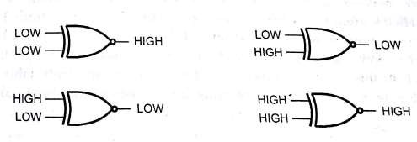
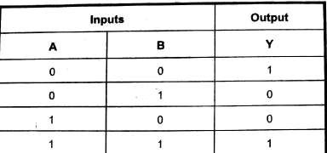
The Exclusive NOR Gate
12/1/2023
Manish Kumar(Asst prof,ECE)

Slide 23
Universal Gate – NAND
This presentation will demonstrate
The basic function of the NAND gate.
How a NAND gate can be used to replace an AND gate, an OR
gate, or an INVERTER gate.
How a logic circuit implemented with AOI logic gates can be
re-implemented using only NAND gates.
That using a single gate type, in this case NAND, will reduce the number of integrated circuits (IC) required to implement a logic circuit.
23

Slide 24

NAND Gate
X Y
Z = X Y = X + Y
X | Y | Z
0 | 0 | 1
0 | 1 | 1
1 | 0 | 1
1 | 1 | 0
24

Slide 25

NAND Gate as an Inverter
X• X = X (Before Bubble)
X
Z = X
X | Z
0 | 1
1 | 0
Equivalent to Inverter
25

Slide 26

NAND Gate as an AND Gate
Z = X Y = X Y
X
Y
NAND Gate
Inverter
X | Y | Z
0 | 0 | 0
0 | 1 | 0
1 | 0 | 0
1 | 1 | 1
Equivalent to AND Gate
26

Slide 27
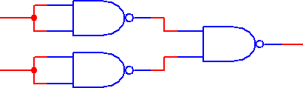
NAND Gate as an OR Gate
X
Y
Z = X Y = X + Y = X + Y
Y
Inverters
NAND Gate
X | Y | Z
0 | 0 | 0
0 | 1 | 1
1 | 0 | 1
1 | 1 | 1
Equivalent to OR Gate
27

Slide 28






NAND Gate Equivalent to AOI Gates
OR
AND
INVERTER
28

Slide 29
Universal Gate – NOR
This presentation will demonstrate…
The basic function of the NOR gate.
How an NOR gate can be using to replace an AND gate, an OR
gate or an INVERTER gate.
How a logic circuit implemented with AOI logic gates could be
re-implemented using only NOR gates
That using a single gate type, in this case NOR, will reduce the number of integrated circuits (IC) required to implement a logic circuit.
29

Slide 30

NOR Gate
X Y
Z = X + Y = X Y
X | Y | Z
0 | 0 | 1
0 | 1 | 0
1 | 0 | 0
1 | 1 | 0
30

Slide 31

NOR Gate as an Inverter
_{at}X_{e}+ X = X (Before Bubble)
X
Z = X
X | Z
0 | 1
1 | 0
Equivalent to Inverter
31

Slide 32

NOR Gate as an OR Gate
X + Y
X
Y
Z = X + Y = X + Y
NOR Gate
“Inverter”
X | Y | Z
0 | 0 | 0
0 | 1 | 1
1 | 0 | 1
1 | 1 | 1
Equivalent to OR Gate
32

Slide 33
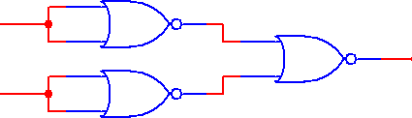
NOR Gate aXs an AND Gate
X
Y
Z = X + Y = X Y = X Y
Y
“Inverters”
NOR Gate
X | Y | Z
0 | 0 | 0
0 | 1 | 0
1 | 0 | 0
1 | 1 | 1
Equivalent to AND Gate
33

Slide 34
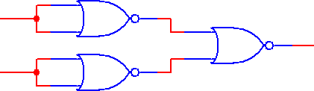


NOR Gate Equivalent of AOI Gates
OR
AND
INVERTER
34

Slide 35

Number Systems
1-Dec-23
Manish kumar Dept of ECE , SNIST
25

Slide 36
Number Systems
Positive radix, positional number systems
A number with radix (base) r (or b) is represented by a string of digits (n in integer and m in fraction):
^{A}n - 1^{A}n - 2 ^{… A}1^{A}0 ^{. A}- 1 ^{A}- 2 ^{… A}- m
Integer Part
Fraction Part
where “.” is the radix point.
Manish kumar Dept of ECE , SNIST
26

Slide 37
The string of digits represents the power series:
j = - 1
i = n - 1
∑A
_{r} i
_{r} j
∑ A
j = - m
-ve exponents
(Number)
r
=
i
+
j
i = 0
+ve exponents
(Integer Portion)
+
(Fraction Portion)
1-Dec-23
Manish kumar Dept of ECE , SNIST

Slide 38
Number Systems Used in Computers
Name of Radix | Radix | Set of Digits Example
Decimal | r=10 | {0,1,2,3,4,5,6,7,8,9} 259₁₀
Binary | r=2 | {0,1} 11101111₂
Octal | r= 8 | {0,1,2,3,4,5,6,7} 377₈
Hexadecimal | r=16 | {0,1,2,3,4,5,6,7,8,9,A, B, C, D, E, F} FF₁₆
1-Dec-23
Manish kumar Dept of ECE , SNIST

Slide 39
Decimal | 0 | 1 | 2 | 3 | 4 | 5 | 6 | 7 | 8 | 9 | 10 | 11 | 12 | 13 | 14 | 15
Hex | 0 | 1 | 2 | 3 | 4 | 5 | 6 | 7 | 8 | 9 | A | B | C | D | E | F
Binary | 0000 | 0001 | 0010 | 0011 | 0100 | 0101 | 0110 | 0111 | 1000 | 1001 | 1010 | 1011 | 1100 | 1101 | 1110 | 1111
Octal | 0 | 1 | 2 | 3 | 4 | 5 | 6 | 7 | 10 | 11 | 12 | 13 | 14 | 15 | 16 | 17
Magic No: * * 8 4 2 1
1-Dec-23
Manish kumar Dept of ECE , SNIST

Slide 40
Positive Powers of 2
Powers of 2
Exponent | Value
0 | 1
1 | 2
2 | 4
3 | 8
4 | 16
5 | 32
6 | 64
7 | 128
8 | 256
9 | 512
10 | 1024
Exponent | Value
11 | 2,048
12 | 4,096
13 | 8,192
14 | 16,384
15 | 32,768
16 | 65,536
17 | 131,072
18 | 262,144
19 | 524,288
20 | 1,048,576
21 | 2,097,152
2 K
4 K
8 K
16 K
= 215 = 25 x 210 = 32 K
64 K
128 K
256 K
512 K
1 M
2 M
1 K
1-Dec-23
Manish kumar Dept of ECE , SNIST

Slide 41
Binary Numbers:
Special Powers of 2
₂10
(1024) is Kilo, denoted "K"
2²⁰ (1,048,576) is Mega, denoted "M"
2³⁰ (1,073, 741,824) is Giga, denoted "G"
2⁴⁰ (1,099,511,628) is Tera, denoted “T"
1-Dec-23
Manish kumar Dept of ECE , SNIST

Slide 42
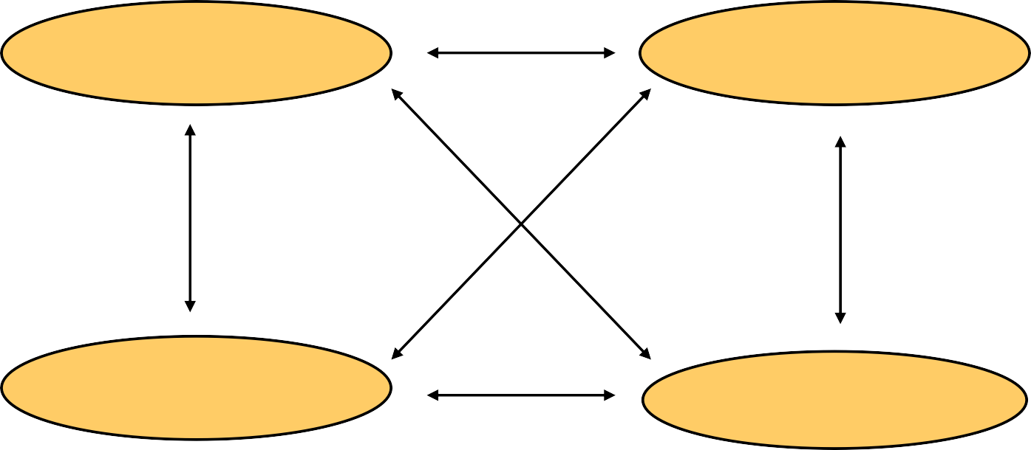
Number - Base Conversion
The possibilities:
Decimal
Octal
Binary
Hexadecimal
1-Dec-23
Manish kumar Dept of ECE , SNIST

Slide 43
Decimal to Decimal (just for fun)
Decimal
Octal
Binary
Hexadecimal
125₁₀ => 1 x 10²+2 x 10¹ +5 x 10⁰=125
1-Dec-23
Manish kumar Dept of ECE , SNIST

Slide 44
Binary to Decimal
Decimal
Octal
Binary
Hexadecimal
1-Dec-23
Manish kumar Dept of ECE , SNIST

Slide 45
Binary to Decimal
Technique
Multiply each bit by 2^{n}, where n is the “weig ht” of the bit
The weight is the position of the bit, starti ng from 0 on the right side
Add the results
1-Dec-23
Manish kumar Dept of ECE , SNIST

Slide 46
Examples
EX1:
101011₂ => 1x2⁵+0x2⁴+1x2³+0x2²+1x2¹+1x2⁰ =43
EX2:
( 1 0 1 1 0 . 0 1 0 1 )2
= 0+2¹ + 2² +0+ (2^4) +0+( 2^-2)+ 0 + (2^-4)
(10110.0101)2 = 2 + 4 + 16 + (1/4) + (1/16)
(10110.0101)2 = 22.3125
1-Dec-23
Manish kumar Dept of ECE , SNIST

Slide 47




What is the largest binary number that can be expressed with 12 bits? What is the equivalent decimal ?
Binary:
(111111111111)2
Decimal:
(111111111111)2 = 1x 2º+ 1 x 2¹ + 1 x 2² +…..+ 1 x 2¹¹
(111111111111)2 = 4,095
1-Dec-23
Manish kumar Dept of ECE , SNIST

Slide 48
Octal to Decimal
Decimal
Octal
Binary
Hexadecimal
1-Dec-23
Manish kumar Dept of ECE , SNIST

Slide 49
Octal to Decimal
Technique
Multiply each bit by 8^{n}, where n is the “weight” of the bit
The weight is the position of the bit, starting from 0 on the right side
Add the results
Example:MSB -LSB(Least significat Bit)
724₈ => 7x8²+2x8¹+4x8⁰ = 468₁₀
1-Dec-23
Manish kumar Dept of ECE , SNIST

Slide 50
Hexadecimal to Decimal
Decimal
Octal
Binary
Hexadecimal
1-Dec-23
Manish kumar Dept of ECE , SNIST

Slide 51
Hexadecimal to Decimal
Technique
Multiply each bit by 16^{n}, where n is the “wei ght” of the bit
The weight is the position of the bit, starti ng from 0 on the right side
Add the results
1-Dec-23
Manish kumar Dept of ECE , SNIST

Slide 52
Example
ABC.₁₆ =>C x 16⁰ = 12 x 1 = 12
B x 16¹ = 11 x 16 = 176
A x 16² = 10 x 256 = 2560
2748₁₀
1-Dec-23
Manish kumar Dept of ECE , SNIST

Slide 53
Decimal to Binary
Decimal
Octal
Binary
Hexadecimal
1-Dec-23
Manish kumar Dept of ECE , SNIST

Slide 54
Decimal to Binary
Integer part conversion
Successive division by two, keep track of the remainde r until quotient is zero.
The first remainder is least-significant bit
The last remainder is most-significant bit
Fractional part conversion.
Successive multiplication by two. The integer part of t he product becomes a numeral in the binary take it a si de.
The fractional part is again multiplied by two and this process is repeated untill fractional part reaches zero
The first product integer is MSB and last product integ er is LSB bits
1-Dec-23
Manish kumar Dept of ECE , SNIST

Slide 55
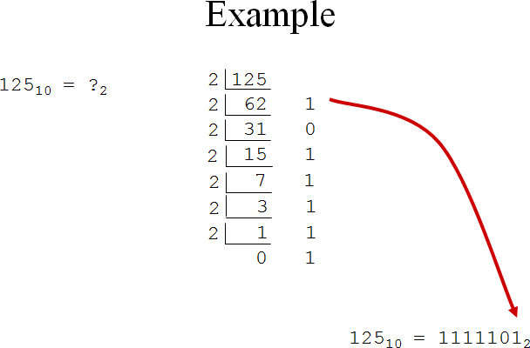
1-Dec-23
Manish kumar Dept of ECE , SNIST

Slide 56
Convert the decimal number 345 to binary
Number | Divided by 2 | Remainder
345 | 345/2=172 | 1
172 | 172/2=86 | 0
86 | 86/2=43 | 0
43 | 43/2=21 | 1
21 | 21/2=10 | 1
10 | 10/2=5 | 0
5 | 5/2=2 | 1
2 | 2/2=1 | 1
(345)10
1-Dec-23
Manish kumar Dept of ECE , SNIST

Slide 57
Convert decimal 34.4375 to binary
(a)
34.4375
34
0.4375
34/2=17 r=0
0.4375*2=0.875 r=0
17/2=8 r=1
8/2=4 r=0
4/2=2 r=0
2/2=1 r=0
0.875*2=1.75 r=1
0.75*2=1.5 r=1
0.5*2=1.0 r=1
0*2=0 r=0
0.4375=(0.01110)2
34=(100010)2
34.4375=(100010.01110)2
1-Dec-23
Manish kumar Dept of ECE , SNIST

Slide 58
Decimal to Octal
Decimal
Octal
Binary
Hexadecimal
1-Dec-23
Manish kumar Dept of ECE , SNIST

Slide 59
Decimal to Octal
Integer part conversion
Successive division by 8, keep track of the remainde r until quotient is zero.
The first remainder is least-significant bit
The last remainder is most-significant bit
Fractional part conversion.
Successive multiplication by 8. The integer part of th e product becomes a numeral in the octal take it a sid e.
The fractional part is again multiplied by 8 and this process is repeated until fractional part reaches zero
The first product integer is MSB and last product int eger is LSB bits
1-Dec-23
Manish kumar Dept of ECE , SNIST

Slide 60
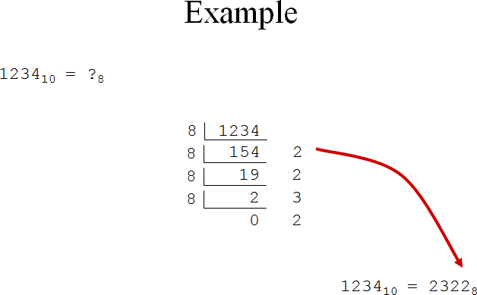
1-Dec-23
Manish kumar Dept of ECE , SNIST

Slide 61
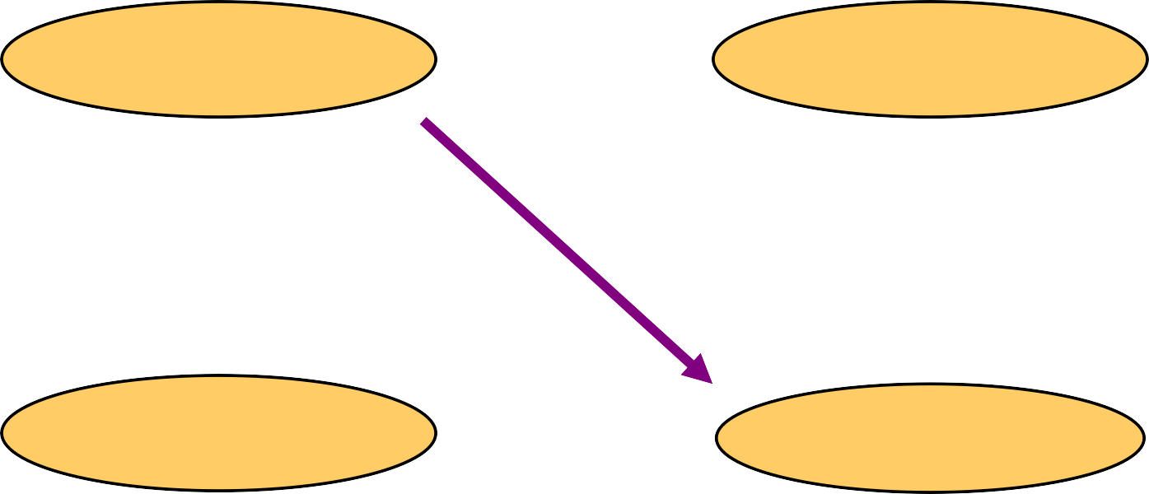
Decimal to Hexadecimal
Decimal
Octal
Binary
Hexadecimal
1-Dec-23
Manish kumar Dept of ECE , SNIST

Slide 62
Decimal to Hexadecimal
Integer part conversion
Successive division by 16, keep track of the remaind er until quotient is zero.
The first remainder is least-significant bit
The last remainder is most-significant bit
Fractional part conversion.
Successive multiplication by 16. The integer part of t he product becomes a numeral in the hexadecimal, ta ke it a side.
The fractional part is again multiplied by 16 and this process is repeated until fractional part reaches zero
The first product integer is MSB and last product int eger is LSB bits
1-Dec-23
Manish kumar Dept of ECE , SNIST

Slide 63
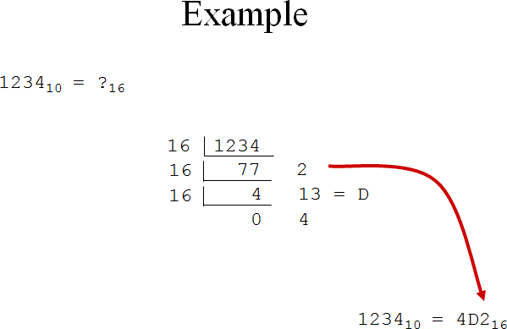
1-Dec-23
Manish kumar Dept of ECE , SNIST

Slide 64
Octal to Binary
Decimal
Octal
Binary
Hexadecimal
1-Dec-23
Manish kumar Dept of ECE , SNIST

Slide 65
Octal to Binary
Technique
– Convert each octal digit to a 3-bit equivalent binary representation
1-Dec-23
Manish kumar Dept of ECE , SNIST

Slide 66
Example
705₈ = ?₂
7 0 5
111 000 101
705₈ = 111000101₂
1-Dec-23
Manish kumar Dept of ECE , SNIST

Slide 67
Hexadecimal to Binary
Decimal
Octal
Binary
Hexadecimal
1-Dec-23
Manish kumar Dept of ECE , SNIST

Slide 68
Hexadecimal to Binary
Technique
– Convert each hexadecimal digit to a 4-bit eq uivalent binary representation
1-Dec-23
Manish kumar Dept of ECE , SNIST

Slide 69
Example
10AF₁₆ = ?₂
1
0 A F
0001 0000 1010 1111
10AF₁₆ = 0001000010101111₂
1-Dec-23
Manish kumar Dept of ECE , SNIST

Slide 70
Binary to Octal
Decimal
Octal
Binary
Hexadecimal
1-Dec-23
Manish kumar Dept of ECE , SNIST

Slide 71
Binary to Octal
Technique
Group bits in threes, starting on right
Convert to octal digits
1-Dec-23
Manish kumar Dept of ECE , SNIST

Slide 72
Example
1011010111₂ = ?₈
1 011 010 111
1 3 2 7
1011010111₂ = 1327₈
1-Dec-23
Manish kumar Dept of ECE , SNIST

Slide 73
Hexadecimal to Octal
Decimal
Octal
Binary
Hexadecimal
1-Dec-23
Manish kumar Dept of ECE , SNIST

Slide 74
Hexadecimal to Octal
Technique
–Use binary as an intermediate number
1-Dec-23
Manish kumar Dept of ECE , SNIST

Slide 75
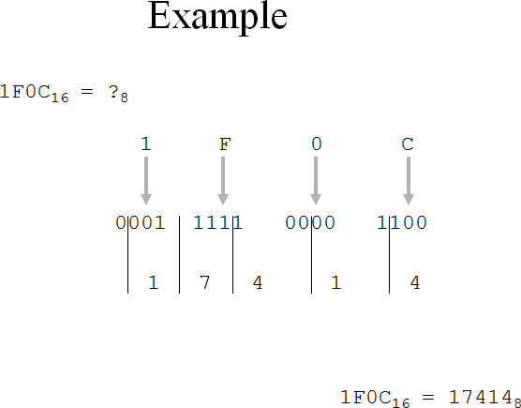
1-Dec-23
Manish kumar Dept of ECE , SNIST

Slide 76
Binary to Hexadecimal
Decimal
Octal
Binary
Hexadecimal
1-Dec-23
Manish kumar Dept of ECE , SNIST

Slide 77
Binary to Hexadecimal
Technique
–Group bits in fours, starting on right
–Convert to hexadecimal digits
1-Dec-23
Manish kumar Dept of ECE , SNIST

Slide 78
Example
1010111011₂ = ?₁₆
10 1011 1011
2 B B
1010111011₂ = 2BB₁₆
1-Dec-23
Manish kumar Dept of ECE , SNIST

Slide 79
What is the largest binary number that can be expressed with 1 2 bits? What is the equivalent hexadecimal ?
Binary:
(111111111111)2
Hexadecimal:
(1111 1111 1111)2
F F
F =
(FFF)16
1-Dec-23
Manish kumar Dept of ECE , SNIST

Slide 80




Convert the given binary number 1.11010 to hexadecimal num ber
( 1 . 1101 0 )2 = ( 1 . D )16
1 D 0
0 -1
1-Dec-23
Manish kumar Dept of ECE , SNIST

Slide 81
Octal to Hexadecimal
Decimal
Octal
Binary
Hexadecimal
1-Dec-23
Manish kumar Dept of ECE , SNIST

Slide 82
Octal to Hexadecimal
Technique
–Use binary as an intermediary
1-Dec-23
Manish kumar Dept of ECE , SNIST

Slide 83
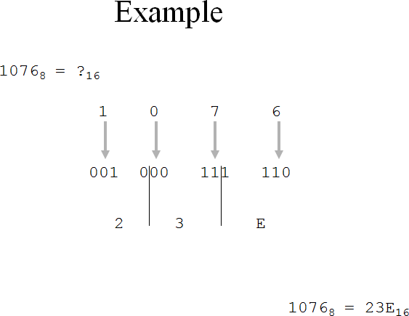
1-Dec-23
Manish kumar Dept of ECE , SNIST

Slide 84

(68BE) 16
Convert the hexadecimal number 68BE to binary and then bina ry to octal .
Binary form:
(0110 1000 1011 1110)2=(0110100010111110)2
6 8 B E
Octal form:
(0 110 100 010 111 110)2
0 6 4 2 7 6 =(064276)8
1-Dec-23
Manish kumar Dept of ECE , SNIST

Slide 85





Convert the following numbers with the indicated bases to dec imal : (4310)5 , and (198)12 .
(4310)5 = 0 x 5º + 1 x 5¹ + 3 x 5² + 4 x 5³ = 0 + 5 + 75 + 500
(4310)5 = (580)10
(198)12 = 8 x 12º + 9 x 12¹ + 1 x 12² = 8 + 108 + 144
(198)12 = (260)10
1-Dec-23
Manish kumar Dept of ECE , SNIST

Slide 86
Binary Codes
Weighted Codes
8-4-2-1 Code (BCD code)
2-4-2-1 code
6-4-2- -3 code
Unweighted Codes
Excess-3 code
Cyclic code
Gray code
Code conversions
Binary to Gray
Gray to Binary
1-Dec-23
Manish kumar Dept of ECE , SNIST

Slide 87
1’s compliment
2’s compliment
Boolean addition
Boolean subtraction
1-Dec-23
Manish kumar Dept of ECE , SNIST

Slide 88
Binary Codes
Binary codes are of two types:
Weighted Codes
Non weighted or Unweighted Codes
1-Dec-23
Manish kumar Dept of ECE , SNIST

Slide 89
Weighted codes
The main characteristic is that each binary digit is as signed a decimal “weight” and for each group of fou r bits, the sum of the weights of those binary digits whose value is 1 is equal to the decimal number whi ch they represent.
If w₀ ,w₁, w₂ and w₃ are the given weights of the bin ary digits and x₀,x₁, x_{2,}x₃
the corresponding digit values then the decimal num ber is
N= w₃x₃ + w₂x₂ + w₁x₁ + w₀x₀
1-Dec-23
Manish kumar Dept of ECE , SNIST

Slide 90
The sequence of binary digits that represents a decimal number is called a code word
The sequence x₃, x₂, x_{1,} x₀ is the code word for N
Examples of weighted codes
– 8421
– 2421
– 642-3
1-Dec-23
Manish kumar Dept of ECE , SNIST

Slide 91
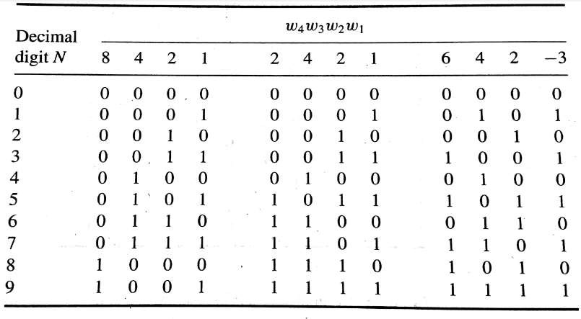
Examples of Weighted Codes
1-Dec-23
Manish kumar Dept of ECE , SNIST

Slide 92
BCD CODE
BCD: Binary-coded decimal, also known as 84 21 code
BCD addition
Similar to add 4-bit unsigned binary numbers.
Make correction if a result exceeds 1001 (9).
By adding 0110 (6).
Carry into the next digit position may come fro m either the initial binary addition or the corre ction-factor addition.
1-Dec-23
Manish kumar Dept of ECE , SNIST

Slide 93
Non weighted codes
There are many nonweighted binary codes, tw o of which are
Excess-3
Gray code
1-Dec-23
Manish kumar Dept of ECE , SNIST

Slide 94
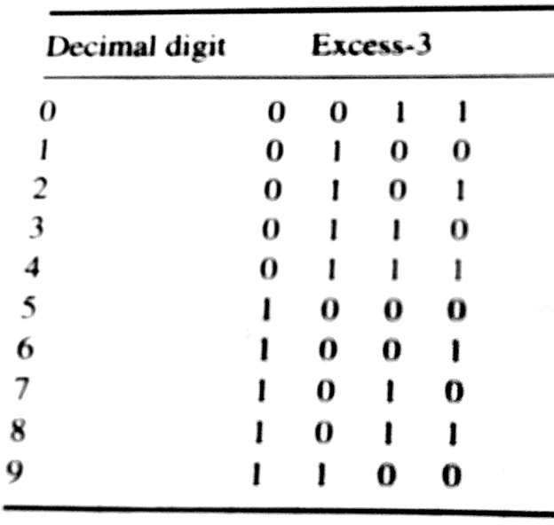
Nonweighted codes
1-Dec-23
Manish kumar Dept of ECE , SNIST

Slide 95
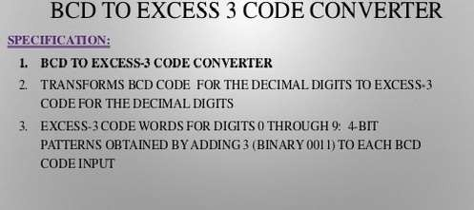
Excess-3 code
Self-complementing code
Not weighted
1-Dec-23
Manish kumar Dept of ECE , SNIST

Slide 96
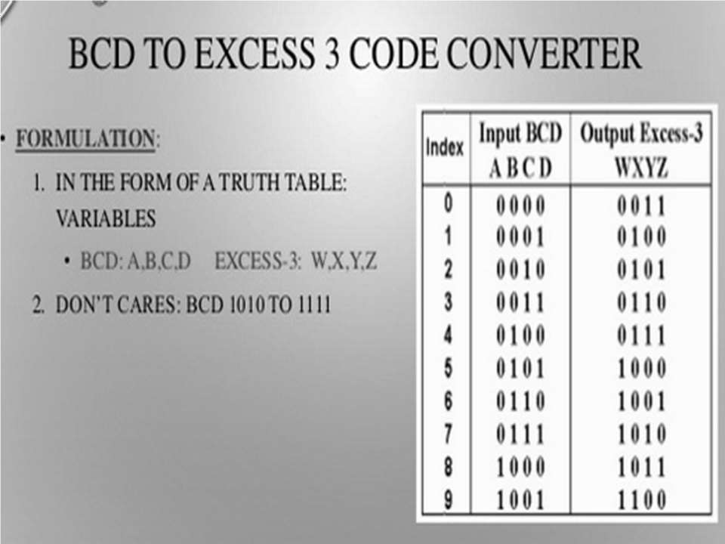
1-Dec-23
Manish kumar Dept of ECE , SNIST

Slide 97
Gray Code
In Practical applications it is desirable to use codes in which the code words for succesive decimal integers differ in only one digit.
In a Gray code only one bit changes between each pai r of successive code words
Gray code is a reflected code or mirror image code It can be defined recursively using the following rules:
A 1-bit Gray code has two code words, 0 and 1.
The first 2^{n} code words of an (n+1)-bit gray code equa l the code words of an n-bit gray code, written in order wit h a leading 0 appended.
1-Dec-23
Manish kumar Dept of ECE , SNIST

Slide 98
3. The last 2^{n} code words of an (n+1)-bit Gray code equal the code words of an n-bit gray code, but written in reverse order with a leading 1 appended.
Example: For a 2-bit Gray code, n=1.
2-bit Gray code
1-bit Gray code
0
0
0
1
0
0
0
1
1
1
1
0
1
1
1
1
0
1-Dec-23
Manish kumar Dept of ECE , SNIST
88

Slide 99
Gray Code
Example: For a 3-bit Gray code, n=2.
3-bit Gray code
0
0
0
0
0
0
0
1
00
00
01
01
10
10
11
01
11
2-bit Gray code
0
0
0
1
1
1
1
1
1
1
1
1
1
0
1
0
1
1
1-Dec-23 1
Manish kumar De0pt of ECE , SNIST
89
0
1

Slide 100






















































The Gray Code
Decimal | Binary | Gray Code
0 | 0000 | 0000
1 | 0001 | 0001
2 | 0010 | 0011
3 | 0011 | 0010
4 | 0100 | 0110
5 | 0101 | 0111
6 | 0110 | 0101
7 | 0111 | 0100
1-Dec-23
Decimal | Binary | Gray Code
8 | 1000 | 1100
9 | 1001 | 1101
10 | 1010 | 1111
11 | 1011 | 1110
12 | 1100 | 1010
13 | 1101 | 1011
14 | 1110 | 1001
15 | 1111 | 1000
Manish kumar Dept of ECE , SNIST
90

Slide 101
Binary to Gray code conversion-1
Binary-to-Gray code conversion
The MSB in the Gray code is the same as correspo nding MSB in the binary number.
Going from left to right, add each adjacent pair of binary code bits to get the next Gray code bit. Disc ard carries.
ex: convert 10110₂ to Gray code
1 + 0 + 1 + 1 + 0 binary
1 1 1 0 1 Gray
1-Dec-23
Manish kumar Dept of ECE , SNIST

Slide 102
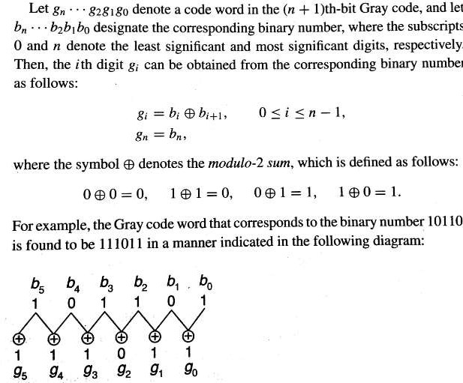
Binary to Gray Code Conversion-2
1-Dec-23
Manish kumar Dept of ECE , SNIST

Slide 103
The Gray to Binary Conversion
Gray-to-Binary Conversion
The MSB in the binary code is the same as the corr esponding bit in the Gray code.
Add each binary code bit generated to the Gray co de bit in the next adjacent position. Discard carries.
ex: convert the Gray code word 11011 to binary
1 1 0 1 1 Gray
+ + + +
1 0 0 1 0 Binary
1-Dec-23
Manish kumar Dept of ECE , SNIST

Slide 104
1’s compliment and 2’s compliment
There are two types of compliments for each number base system.
Have the r’s complement
Have the (r-1)’s complement
For Binary number system (base 2)
we have 2’s complement and 1’s complement
1-Dec-23
Manish kumar Dept of ECE , SNIST

Slide 105
1’s Complement
1’s complement of N = (2^{n} -1)-N.
–If n=4 have (2^{n} -1) being 1 0000
111
- 1 = 1
So for n=4 would subtract any 4-bit binary nu mber from 1111.
This is just inverting each bit.
Example: 1’s compliment of 1011001
is 0100110
1-Dec-23
Manish kumar Dept of ECE , SNIST

Slide 106
2’s complement
The 2’s complement of N= 2^{n}-N
Adding 1 to the 1’s complement of a number.
For 6 = 0110
–The 1’s complement is 1001
–The 2’s complement is 1010
1-Dec-23
Manish kumar Dept of ECE , SNIST

Slide 107
Obtain the 1’s and 2’S complements of the following binary numbers :
(a)11101010 (b)01111110 (c)00000001 (d)10000000
1’s complements:
(a) 00010101 (b)10000001 (c)11111110 (d)01111111
2’s complement :
(a) 00010110 (b)10000010 (c)11111111 (d)10000000
1-Dec-23
Manish kumar Dept of ECE , SNIST

Slide 108
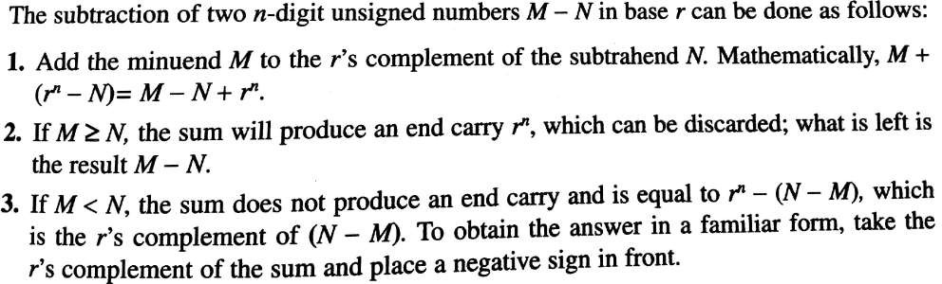
Subtraction with Complements
1-Dec-23
Manish kumar Dept of ECE , SNIST

Slide 109
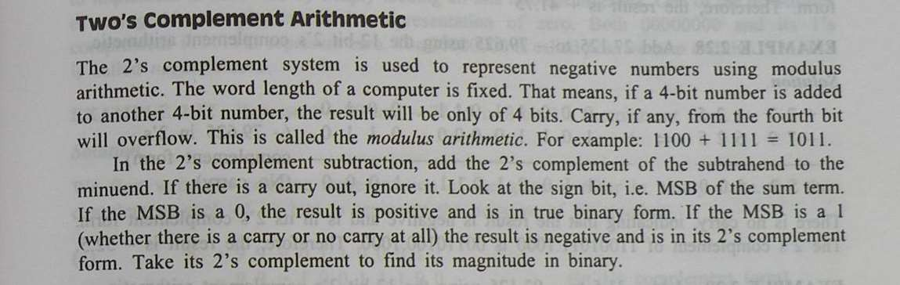
1-Dec-23
Manish kumar Dept of ECE , SNIST

Slide 110
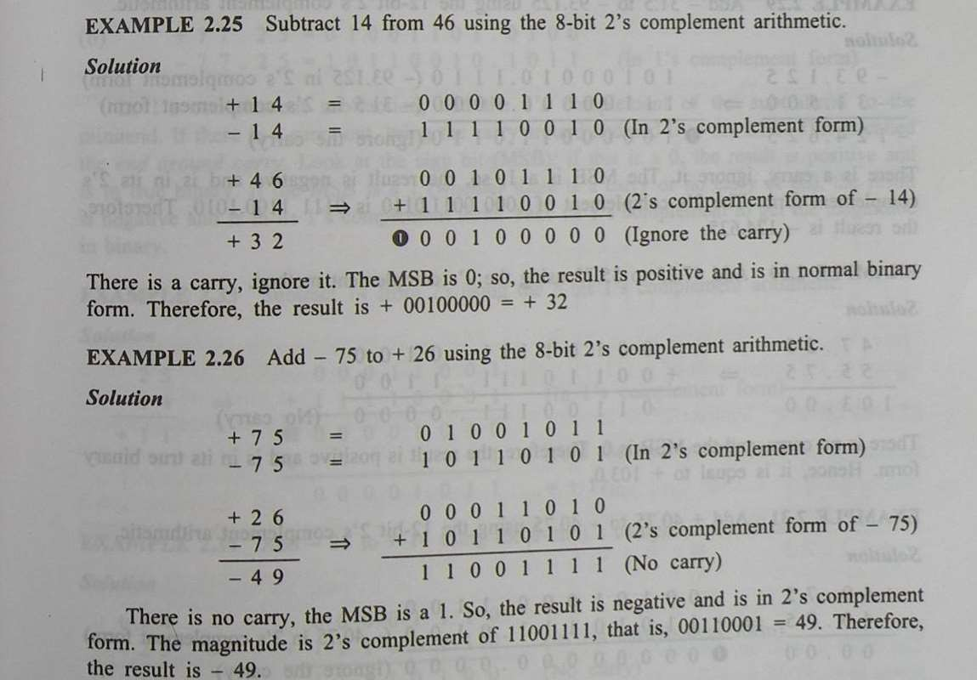
1-Dec-23
Manish kumar Dept of ECE , SNIST

Slide 111
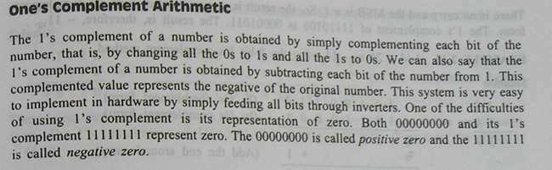
1-Dec-23
Manish kumar Dept of ECE , SNIST

Slide 112
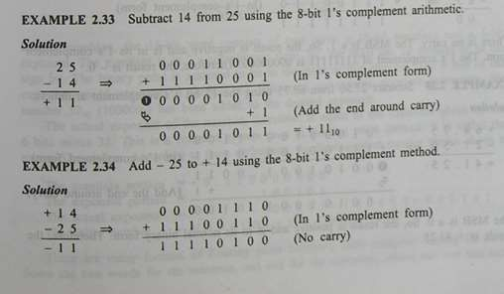

1-Dec-23
Manish kumar Dept of ECE , SNIST

Slide 113
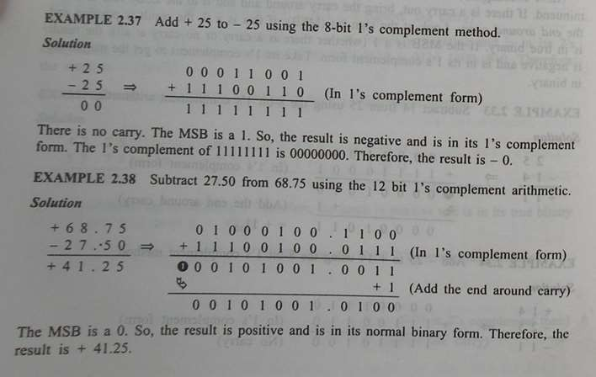
1-Dec-23
Manish kumar Dept of ECE , SNIST

Slide 114

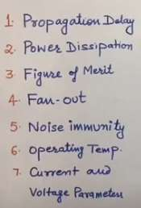
1-Dec-23
Manish kumar Dept of ECE , SNIST

Slide 115
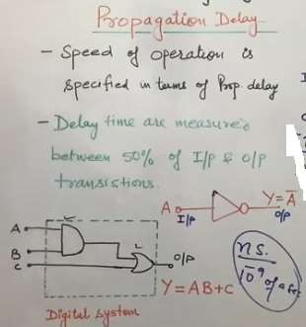
1.Propagation Delay
1-Dec-23
Manish kumar Dept of ECE , SNIST

Slide 116
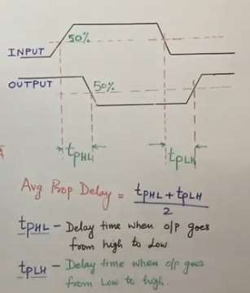

1-Dec-23
Manish kumar Dept of ECE , SNIST

Slide 117
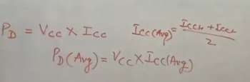
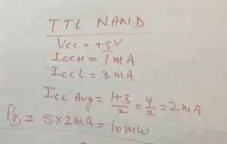
2.Power dissipation
1-Dec-23
Manish kumar Dept of ECE , SNIST

Slide 118
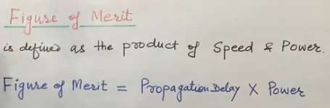


3.Figure of merit
1-Dec-23
Manish kumar Dept of ECE , SNIST

Slide 119
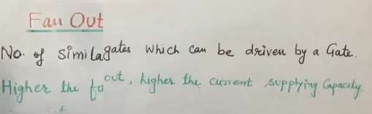
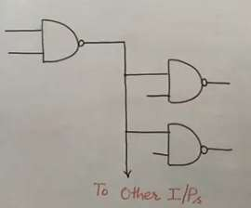
4.Fan out
1-Dec-23
Manish kumar Dept of ECE , SNIST

Slide 120
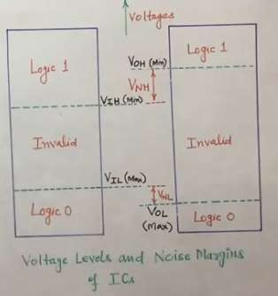


5.Noise Immunity
“The circuit ability to tolerate the noise signal”
1-Dec-23
Manish kumar Dept of ECE , SNIST

Slide 121
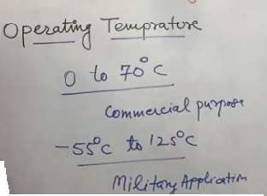
6.Operating Temperature
1-Dec-23
Manish kumar Dept of ECE , SNIST

Slide 122
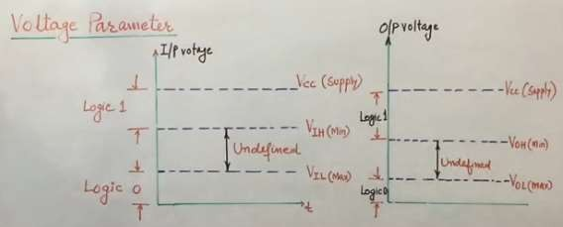
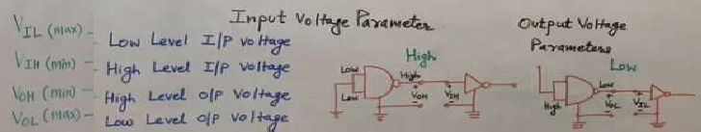
7.Voltage and Current Parameters
1-Dec-23
Manish kumar Dept of ECE , SNIST

Slide 123
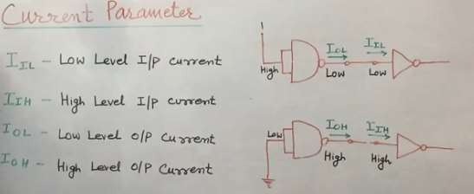
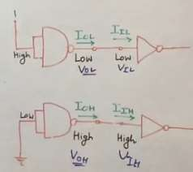
1-Dec-23
Manish kumar Dept of ECE , SNIST

Slide 124
Error Detection& Correction
Types of Errors
Detection
Correction

Slide 125
Sources of errors
a)Electromagnetic distortion of signal: “noise” on the line.
b)Error in sampling pulse relative to neighbor pulse: “inter-symbol interf erence”
c)Energy coupling due to nearby links: “cross-talk”.
d)The storage of information on the mag netic devices is prone to errors due to un even magnetic surface, dust etc.

Slide 126
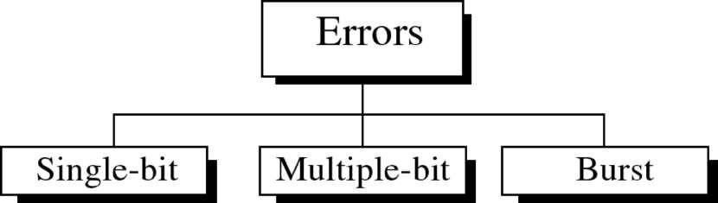
Types of Errors

Slide 127

Single-bit error

Slide 128

Burst error

Slide 129


Slide 130
The term burst error means that two or more bits in the data unit have changed from 1 to 0 or from 0 to 1.
Burst errors does not necessarily mean that the errors occur in consecutive bits, the l ength of the burst is measured from the first corrupted bit to the last corrupted bit.
Some bits in between may not have been corrupted.

Slide 131

Burst error is most likely to happen in transns mission since the duration of noise is normall y longer than the duration of a bit.
The number of bits affected depends on the datrat e and duration of noise.
Example:
If data is sent at rate = 1Kbps then a noise of 1/100 sec can affect 10 bits.(1/100*1000)
If same data is sent at rate = 1Mbps then a noise of1
/100 sec can affect 10,000 bits.(1/100*10⁶)

Slide 132
ERROR DETECTING & ERROR CORRECTING CODES
Todetect aswell ascorrect these errors, various codes are pres
ent and these codes are:
ERROR DETECTING CODES.
ERROR CORRECTING CODES
The first type of code enables the device to detect errors which occurin t he code of the bits and second type of code correct the errors automatic a ly.
The various types of error detection and error correction techniques ar e closely related with the HAMMING DISTANCE between any two code sin the set of codes.

Slide 133
ERROR-DETECTING CODES
PARITY
PARITY is the no. of ones present in the data whereas PARITYBIT is an e xtra bit (that may be 0 or 1) which may be added in the data for makin g the parity to be even or odd. The two different methods are used & t hey are:
EVEN PARITY METHOD.
In this method, the value of parity bit is taken as 0 or 1 depending upon the total no. of 1's IN
CLUDINGTHEPARITYBIT to be even.
ODD PARITY METHOD.
This method is similar to the even parity technique such that total no. of 1's INCLUDINGTHEPARITY BI
T would be odd.
For detection of error an extra bit known as parity bit is attached to eac h code word to make the no. of ones in the code even(even parity) or o dd(odd parity).

Slide 134
ERROR-DETECTING
CODES
BCDcodewith even parity BCDcodewith oddparity
BCDcode
D | C | B | A | P | D | C | B | A | P | D | C B | A
0 | 0 | 0 | 0 | 0 | 0 | 0 | 0 0 |  | 1 | 0 | 0 0 | 0
0 | 0 | 0 | 1 | 1 | 0 | 0 | 0 1 |  | 0 | 0 | 0 0 | 1
0 | 0 | 1 | 0 | 1 | 0 | 0 | 1 0 |  | 0 | 0 | 0 1 | 0
0 | 0 | 1 | 1 | 0 | 0 | 0 | 1 1 |  | 1 | 0 | 0 1 | 1
0 | 1 | 0 | 0 | 1 | 0 | 1 | 0 0 |  | 0 | 0 | 1 0 | 0
0 | 1 | 0 | 1 | 0 | 0 | 1 | 0 1 |  | 1 | 0 | 1 0 | 1
0 | 1 | 1 | 0 | 0 | 0 | 1 | 1 0 |  | 1 | 0 | 1 1 | 0
0 | 1 | 1 | 1 | 1 | 0 | 1 | 1 1 |  | 0 | 0 | 1 1 | 1
0 | 0 | 0 | 0 | 1 | 1 | 0 | 0 0 |  | 0 | 1 | 0 0 | 0
0 | 0 | 1 | 0 | 0 | 1 | 0 | 0 1 |  | 1 | 1 | 0 0 | 1

Slide 135
Error
Correction
It can be handled in two ways:
receiver can have the sender retransmit the entire data unit.
The receiver can use an error-correcting code, which automatically corrects certain errors.

Slide 136

To correct an error, the receiver reverses the value of the altered bit. To do so, it must know which bit is in error.
Single-bit error correction
Number of redundancy bits needed
Let data bits = m
Redundancy bits = r
Total message sent = m+r
The value of r must satisfy the following relation:
2^{r} ≥ m+r+1

Slide 137

Error Correction

Slide 138
Hamming Codes
HAMMING CODE :
is constructed by adding a no. of parity bits to each group of n-bit inform ation, or message in such a way so as to be able to locate the bit position in which error occurs.
Values (0 or 1) are assigned to the parity bits so as to make the hamming code have either even parity or odd parity & when an error occurs, the position no. will take on the value assigned to the location of the errone ous bit.

Slide 139

Hamming Code

Slide 140
Hamming Codes
Hamming Codes
Construction for 1-bit error-correcting codes Minimal number of check bitsrequired
Construction
number bits from 1upward powers of 2 are check bits al l others are databits
Check bit j is XORof all bits k such that (j AND k) =j
Example:
4 bits of data, 3 checkbits

Slide 141


Slide 142


Slide 143
ERROR CORRECTING CODES
ERROR DETECTING &
There are many types of codes for error detection and correction e.g. parity bit
is a kind of error detection code that can find only one bit error
in the data.
Hamming code is an error detection and correction code.
These codes are used in detecting and correcting error in the transmitted dig ital data and it helps in the error free transmission of the data.

Slide 144

Hamming Code

Slide 145

Hamming Code

Slide 146

Example of Hamming Code

Slide 147

Single-bit error

Slide 148

Error Detection

Slide 149
Assignment-2
Generate the hamming code for data 111011001 with even parity ?

